Slide 1
Unit 12 Time Series
Adding Covariates

Slide 2
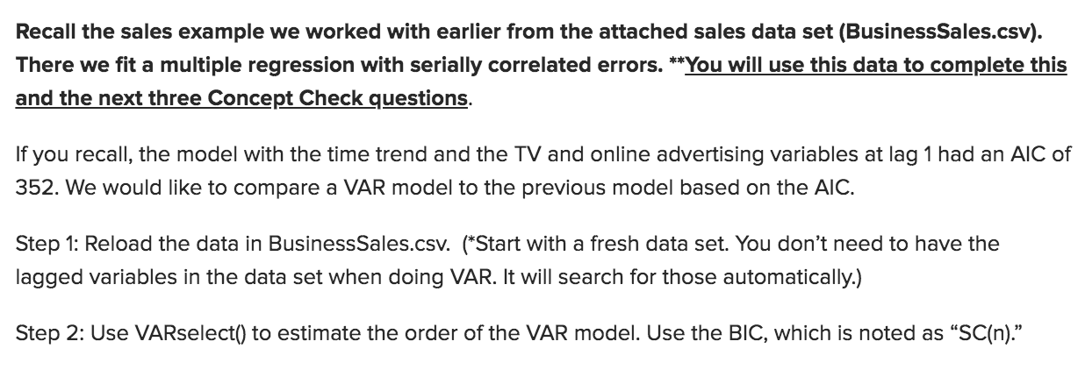
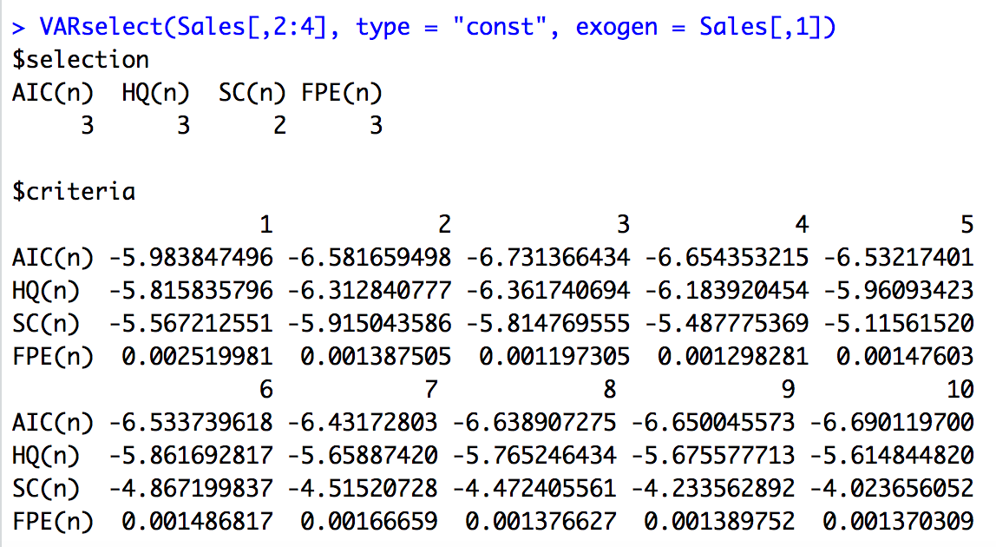
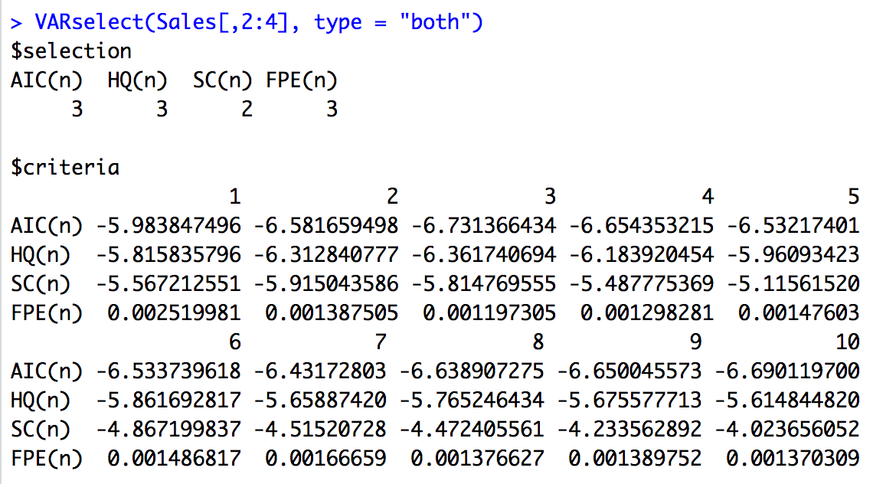
Review of Sales Data Concept Check

Slide 3
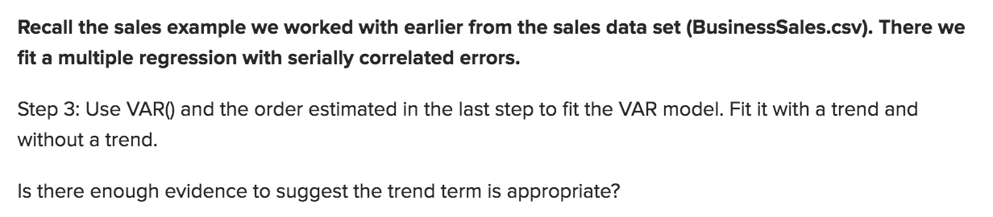
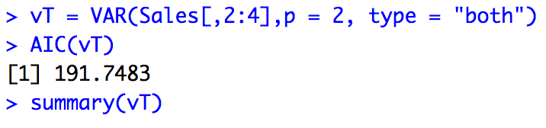
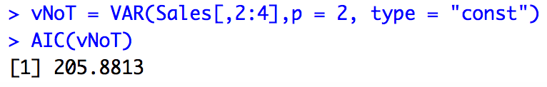
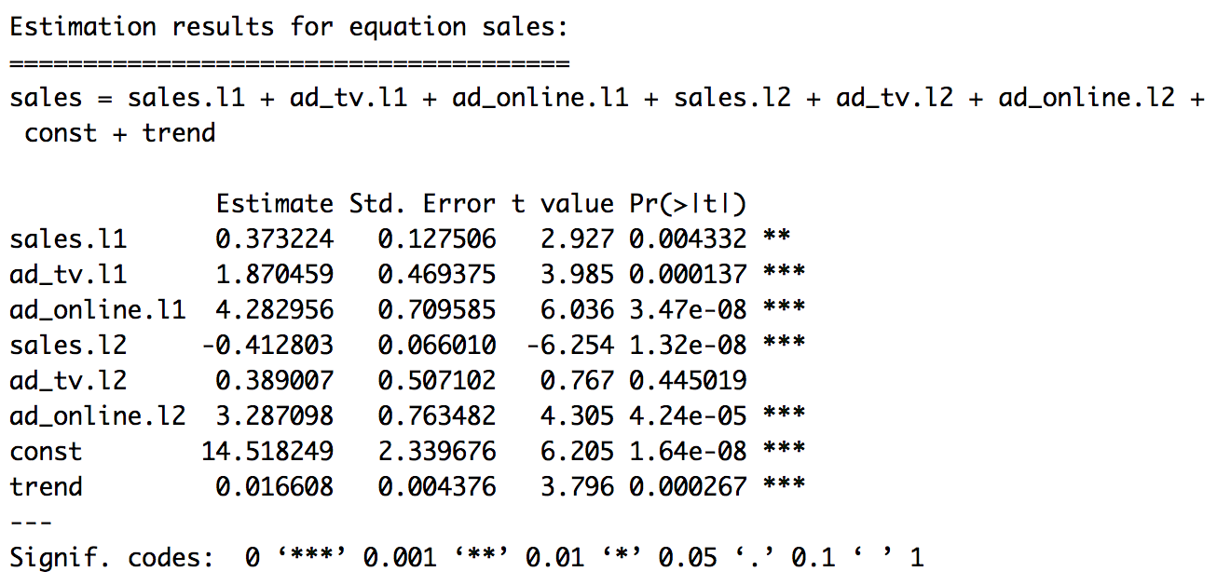
Review of Sales Data Concept Check

Slide 4

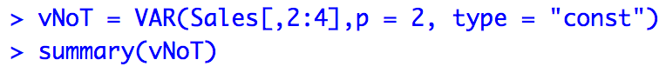
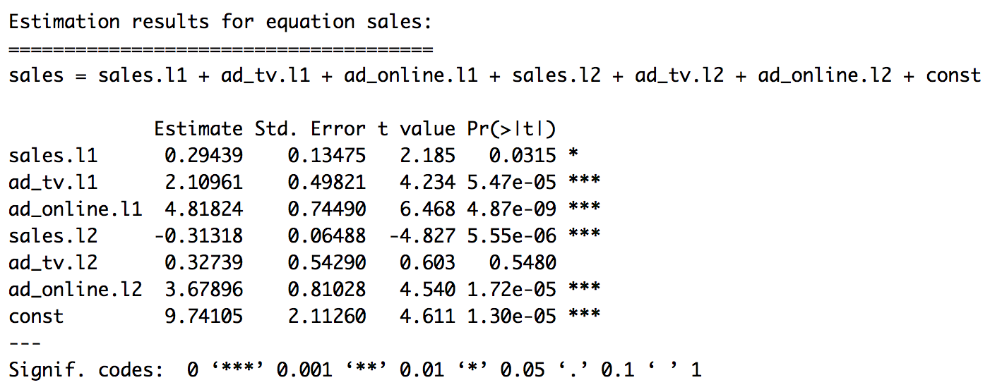
Review of Sales Data Concept Check

Slide 5
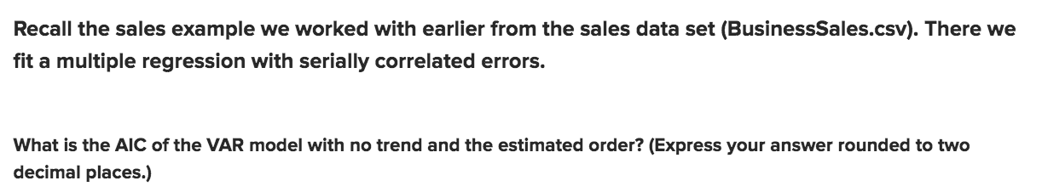
Review of Sales Data Concept Check

Slide 6

Break Out 1: LA Pollution Data

Slide 7
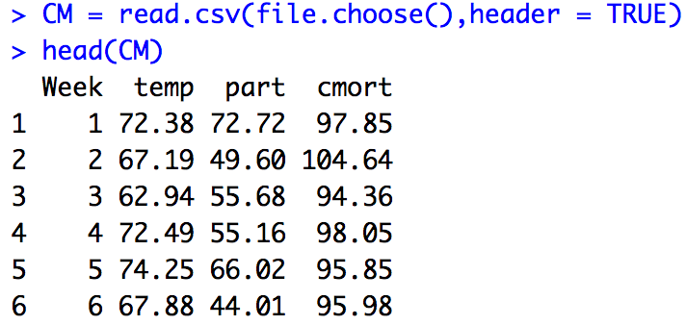
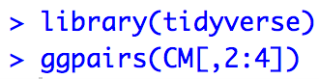
Break Out 1: LA Pollution Data

Slide 8
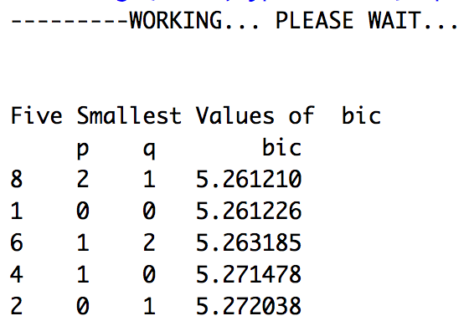
Break Out 1: LA Pollution Data (MLR)
Forecast Next 20 Particle Counts
plotts.sample.wge(CM$part) #freq near .0192 (annual)
CM_52 = artrans.wge(CM$part, c(rep(0,51),1))
aic5.wge(CM_52,type = "bic") #picks ARMA(0,0)
ljung.wge(CM_52)$pval #FTR Ho (pval = .06)
ljung.wge(CM_52, K = 48)$pval #FTR Ho (pval = .22)
predsPart = fore.aruma.wge(CM$part,s = 52, n.ahead = 20)

Slide 9
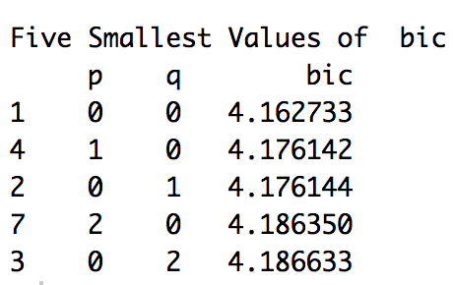
Break Out 1: LA Pollution Data (MLR)
Forecast Next 20 Temperatures
plotts.sample.wge(CM$temp) #freq near .0192 (annual)
CM_52 = artrans.wge(CM$temp, c(rep(0,51),1))
aic5.wge(CM_52,type = "bic") #picks ARMA(0,0)
ljung.wge(CM_52)$pval #FTR Ho (pval = .129)
ljung.wge(CM_52, K = 48)$pval #FTR Ho (pval = .03)
acf(CM_52,lag.max = 48) # acf looks consistent with white noise
predsTemp = fore.aruma.wge(CM$part,s = 52, n.ahead = 20)

Slide 10
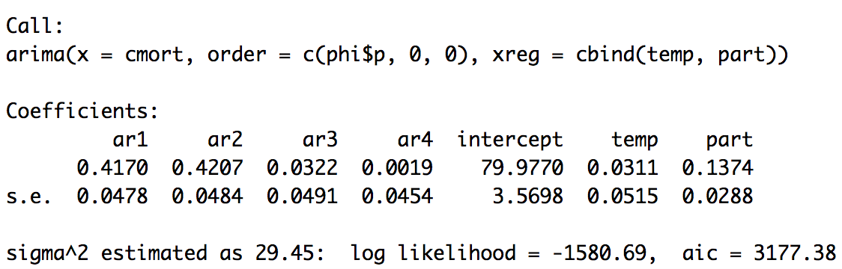
Break Out 1: LA Pollution Data (MLR)
Forecast Next 20 Cardiac Mortality 1 Rates based on forecast Temperature and Particle numbers.
ksfit = lm(cmort~temp+part, data = CM)
phi = aic.wge(ksfit$residuals)
attach(CM)
fit = arima(cmort,order = c(phi$p,0,0), xreg = cbind(temp, part))
# Check for whiteness of residuals
acf(fit$residuals)
ljung.wge(fit$residuals) # pval = .22
ljung.wge(fit$residuals, K = 48) # pval = .08

Slide 11
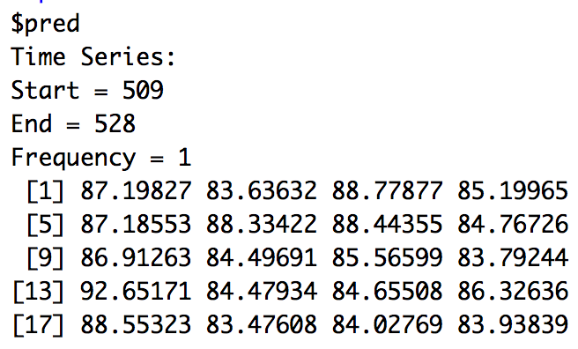
Break Out 1: LA Pollution Data (MLR)
Forecast Next 20 Cardiac Mortality 1 Rates based on forecast Temperature and Particle numbers.
#load the forecasted Part and Temp in a data frame
next20 = data.frame(temp = predsTemp$f, part = predsPart$f)
#get predictions
predsCMort = predict(fit,newxreg = next20)
#plot next 20 cmort wrt time
plot(seq(1,508,1), cmort, type = "l",xlim = c(0,528), ylab = "Cardiac Mortality", xlab = "Week", main = "20 Week Cardiac Mortality Forecast")
lines(seq(509,528,1), predsCMort$pred, type = "l", col = "red")

Slide 12
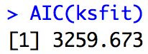
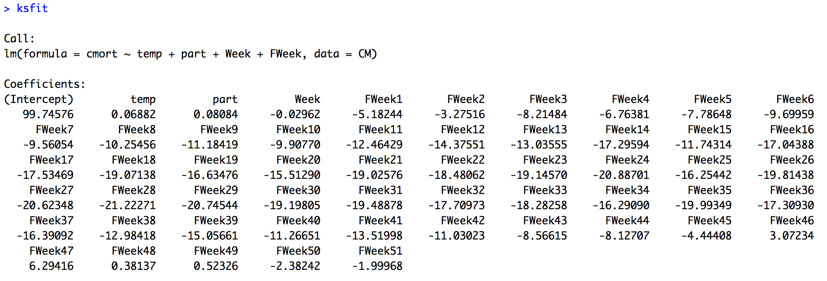
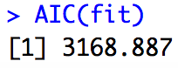
Break Out 1: LA Pollution Data (MLR)
Forecast Next 20 Cardiac Mortality 2 Rates based on forecast Temperature and Particle numbers.
CM$FWeek = as.factor(CM$Week%%52)
ksfit = lm(cmort~temp+part+Week+FWeek, data = CM)
phi = aic.wge(ksfit$residuals)
attach(CM)
fit = arima(cmort,order = c(phi$p,0,0), xreg = cbind(temp, part, Week, FWeek))
# Check for whiteness of residuals
acf(fit$residuals)
ljung.wge(fit$residuals) # pval = .066
ljung.wge(fit$residuals, K = 48) # pval = .0058

Slide 13
Break Out 1: LA Pollution Data (MLR)
Forecast Next 20 Cardiac Mortality 2 Rates based on forecast Temperature and Particle numbers.
#load the forecasted Part and Temp in a data frame
next20 = data.frame(temp = predsTemp$f, part = predsPart$f, Week = seq(509,528,1), FWeek = as.factor(seq(509,528,1)%%52))
#get predictions
predsCMort = predict(fit,newxreg = next20) #creates error because of factor
#predict residuals manually
plotts.sample.wge(ksfit$residuals)
phi = aic.wge(ksfit$residuals)
resids = fore.arma.wge(ksfit$residuals,phi = phi$phi,n.ahead = 20)
#predict trend manually
preds = predict(ksfit, newdata = next20)
predsFinal = preds + resids$f
#plot next 20 cmort wrt time
plot(seq(1,508,1), cmort, type = "l",xlim = c(0,528), ylab = "Cardiac Mortality", main = "20 Week Cardiac Mortality Forecast")
lines(seq(509,528,1), predsFinal, type = "l", col = "red")

Slide 14
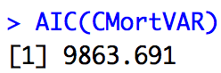
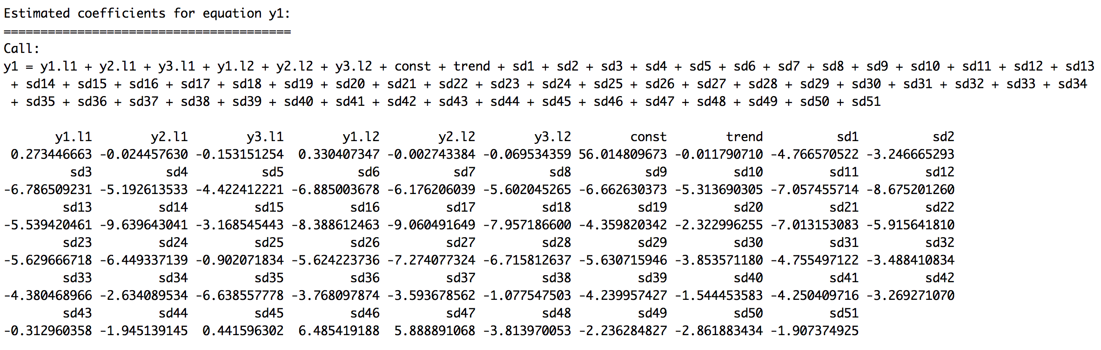
Break Out 1: LA Pollution Data (VAR)
#VAR Forecasts Seasonal Dummy
#VARSelect on Seasonal Data chooses 2
VARselect(cbind(CM$cmort, CM$part, CM$temp),lag.max = 10, season = 52, type = "both")
#VAR with p = 2
CMortVAR = VAR(cbind(CM$cmort, CM$part, CM$temp),season = 52, type = "both",p = 2)
preds=predict(CMortVAR,n.ahead=20)

Slide 15
Break Out 1: LA Pollution Data (VAR)
Forecast Next 20 Cardiac Mortality 2 Rates based on forecast Temperature and Particle numbers.
#VAR Forecasts Seasonal Dummy
#VARSelect on Seasonal Data chooses 2
VARselect(cbind(CM$cmort, CM$part, CM$temp),lag.max = 10, season = 52, type = "both")
#VAR with p = 2
CMortVAR = VAR(cbind(CM$cmort, CM$part, CM$temp),season = 52, type = "both",p = 2)
preds=predict(CMortVAR,n.ahead=20)
#Plot
plot(seq(1,508,1), cmort, type = "l",xlim = c(0,528), ylab = "Cardiac Mortality", main = "20 Week Cardiac Mortality Forecast")
lines(seq(509,528,1), preds$fcst$y1[,1], type = "l", col = "red")

Slide 16

Break Out 2: Sales Data and ASE

Slide 17
Helpful Links
https://www.r-econometrics.com/timeseries/varintro/

